Slide 1
BR US discount sensitivity model
MARCH 2017
PLATFORM ANALYTICS

Slide 2


BACKGROUND
Objective:
Every year company shells out billions of $ in various discounts offered.
Not all Customers have affinity towards discounts to make a purchase.
This creates an opportunity to improve margin by offering relevant discounts to customers based on how discount sensitive they are.
The whole exercise will help in:
Increasing Revenue
Saving Cost
Definitions:
Discount Sensitive: customers availing discounts of 35% or more in last 12 months
Discount Sensitivity Score: Prob of a customer to avail discounts > 35% in next 12 months
Historical behavior
Response Window
Training
Transactions & Browse Data
Jan2015-Dec2015
Purchase Data
Jan2016-Dec2016
Validation
Transactions & Browse Data
Jul’14-Jun’15 and Feb’14-Jan’15
Purchase Data
Jul’15-Jun’16 and Feb’15-Jan’16
Algorithms | Library
Ensemble Leaners | xgboost, ada, adabag, gbm, randomForest
Support Vector Machines | kernlab
Logistic Regression
Deep Learning | mxnet, h2o, tensorflow, darch, scikit-learn
Data preparation
Exploratory Analysis
Scaling and Outlier Treatment
Dataset : 4.7M Customers, Discount Sensitive - 20.2%
Model Execution and Testing
Model Evaluation and Validation
Model Training

Slide 3
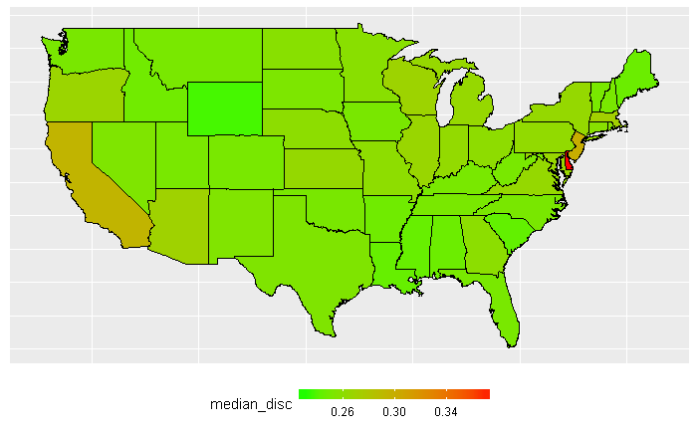
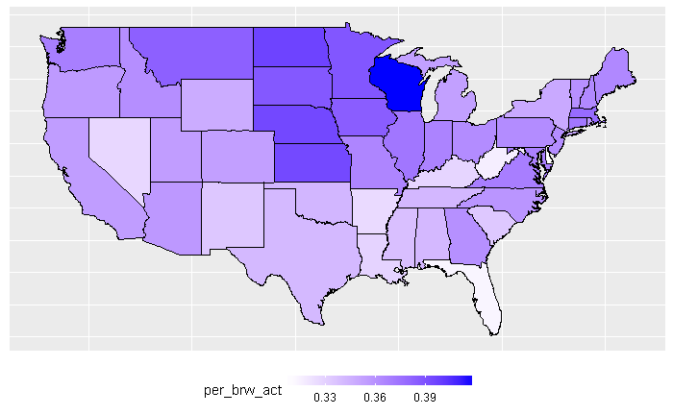
INTERESTING FACTS ABOUT DISCOUNT TAKEN
Discount % availed by customers spread across geographies
Browse activity of customers spread across geographies

Slide 4
PREDICTORS AND RELATIVE IMPORTANCE

Slide 5
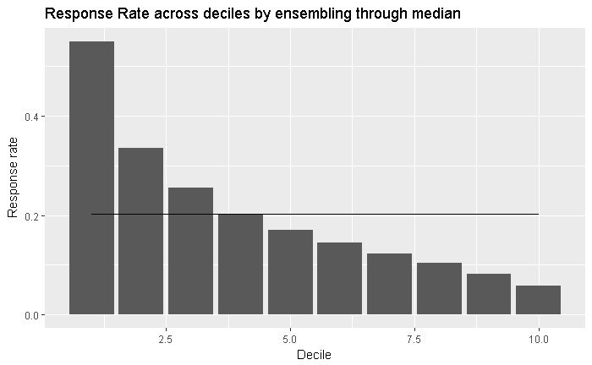
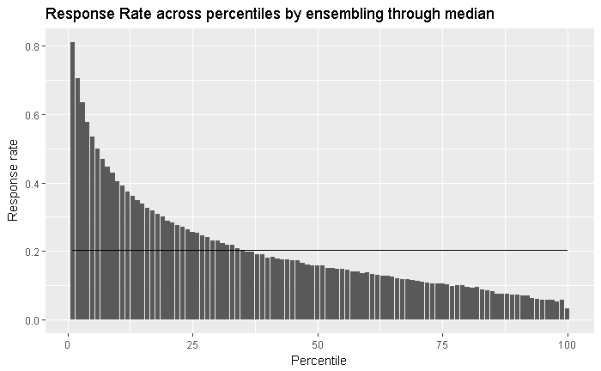
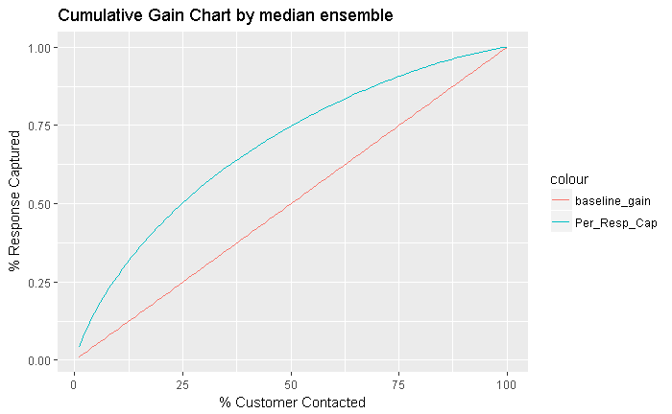
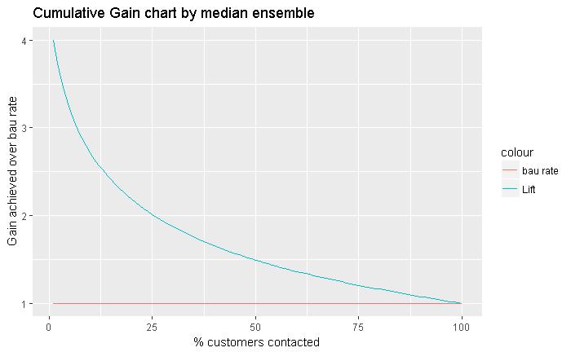
MODEL RESULTS - VALIDATIONS JUL 15-JUN 16
Decile | Customers | Number of Responder | Cum Responders | Response Rate | Response Gain | Cumulative Response Rate | Cumulative Lift
1 | 472,243 | 260,026 | 260,026 | 55.1% | 27.2% | 55.1% | 2.72
2 | 472,244 | 158,415 | 418,441 | 33.5% | 43.7% | 44.3% | 2.19
3 | 472,243 | 120,468 | 538,909 | 25.5% | 56.3% | 38.0% | 1.88
4 | 472,244 | 95,893 | 634,802 | 20.3% | 66.3% | 33.6% | 1.66
5 | 472,244 | 80,267 | 715,069 | 17.0% | 74.7% | 30.3% | 1.49
6 | 472,243 | 68,752 | 783,821 | 14.6% | 81.9% | 27.7% | 1.37
7 | 472,244 | 58,311 | 842,132 | 12.3% | 88.0% | 25.5% | 1.26
8 | 472,243 | 48,850 | 890,982 | 10.3% | 93.1% | 23.6% | 1.16
9 | 472,244 | 38,555 | 929,537 | 8.2% | 97.1% | 21.9% | 1.08
10 | 472,244 | 27,395 | 956,932 | 5.8% | 100.0% | 20.3% | 1.00
Model Summary:
Of all the algorithms/models tested, GBM was picked based on model performance. Out of 2000 GBM models, each trained on a sample of customers from the full dataset, 20 best performing models have been picked and data is scored . The median score of the 20 models was taken as final probability prediction and was used for validations.
Response Rate across deciles by median score from 20 models
Response Rate across percentiles by median score from 20 models
Cum Gains using median score from 20 models
Cum Lift using median score from 20 models

Slide 6
APPENDIX

